Slide 1
Mini Project on CRYPTO CURRENCY -Bitcoins
Guided by,
-Mrs.Rathika
By,
Sarathram.M - 1833049
Kavya.P - 1833022
Sridhar.S - 1833051
Praneetha.T.R - 1833036
Priyadharshini.R - 1833039

Slide 2
OBJECTIVE:
Bitcoins Transaction using Block chain
Prediction of Bitcoin Price
Analysis of Bitcoin

Slide 3
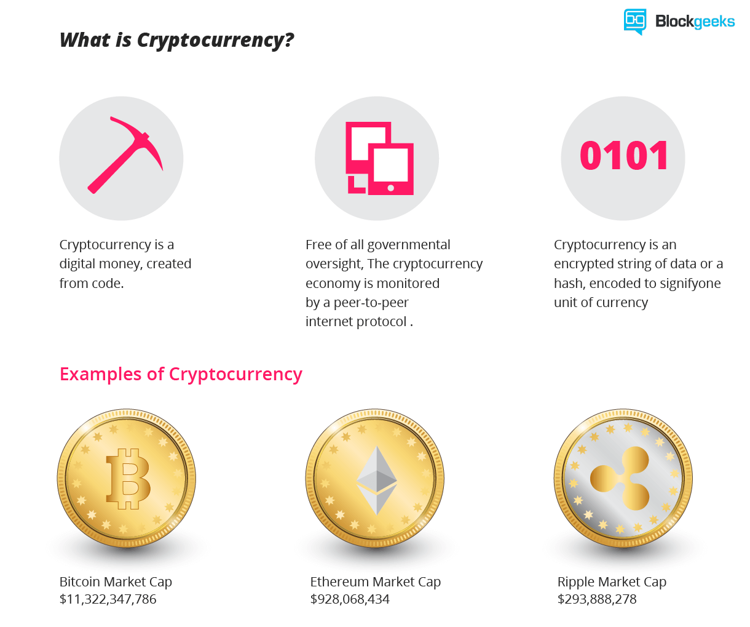
WHAT IS CRYPTOCURRENCY..?
A cryptocurrency (or crypto currency) is a digital asset designed to work as a medium of exchange that uses strong cryptography to secure financial transactions, control the creation of additional units, and verify the transfer of assets.
Cryptocurrencies are digital gold.

Slide 4
BITCOIN
One right decision to make your investment more valuable
It is a decentralized cryptocurrency, not owned by anyone
Transaction made are easy as they are not tied to any country
Uses peer-to-peer network
In India, its not a Legal Tender.

Slide 5
BLOCK CHAIN
Public Ledger that record transactions
Maintained by network of nodes running the bitcoin software
Avoides double-spending
Only place where, bitcoins are said to exist in the form of unspent outputs of transaction

Slide 6
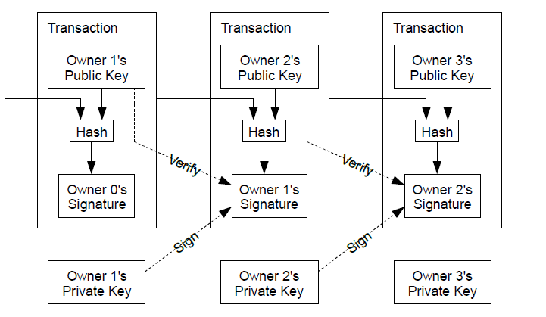
TRANSACTION MODEL

Slide 7
Concept Used:
MANAGEMENT & STATISTICS:
SWOT ANALYSIS
REGRESSION
HYPOTHESIS TESTING
DATA STRUCTURES IN PYTHON & LIBRARIES:
TREES
BINARY SEARCH
NUMPY & SCIPY
PANDAS & MATPLOTLIB
PRETTY TABLE

Slide 8
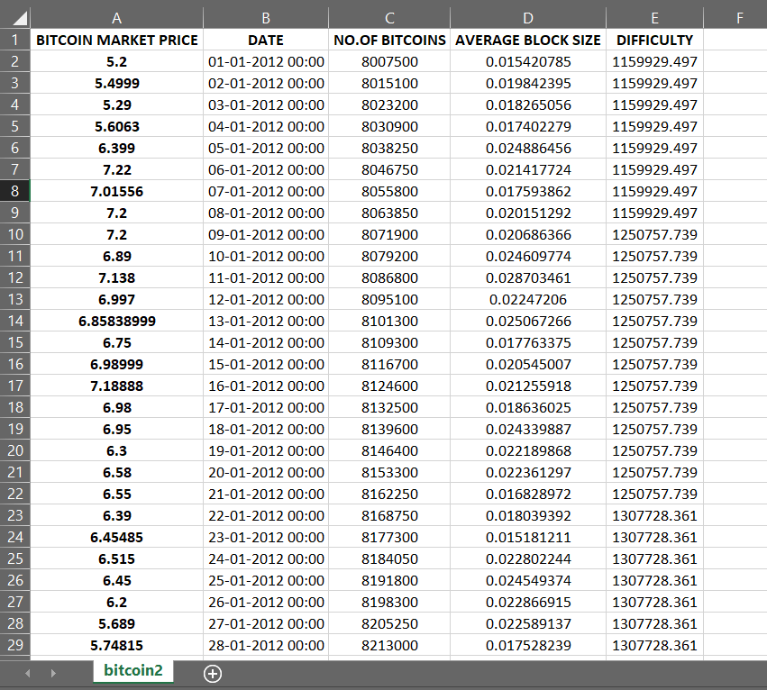
DATASET:
Dataset for bitcoin values from year 2010 January to 2018 February has been obtained.
Reference: www.kaggle.com

Slide 9
SWOT ANALYSIS:
STRENGTH The security offered by bitcoins also play a major role. They cannot be tracked or stolen. It makes bitcoin a tax-free currency. Even if the economy crashes, bitcoin can survive. | WEAKNESS The volatility of bitcoins is most worrying one. It is a decentralized monetary system and has no regulation. The price of bitcoins can neither be determined nor controlled. Crippling slow transactions and accessibility loss.
OPPORTUNITY The world is heading to a cashless economy where you don’t need wallet and some carry material. Many global vendors like amazon have accepting bitcoin as their payment money. Bitcoin is one of thousand potentials of the Blockchain technology | THREATS Bitcoin’s trackless encryption can attract criminals & money launderers to use their money in illegal way. At same time cyber attackers will also be looking for ways to hack into the system by deciphering the long codes. Defending itself against cyber theft is going to be probably the biggest hurdle for bitcoin in the coming years.

Slide 10
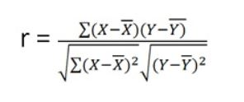

STATISTICAL ANALYSIS
Correlation:
r-Correlation coefficient
X-date
Y-Price value of Bitcoin
Regression:
b= regression coefficient
a= intercept point of the regression line which is in the y-axis.
X=Price to predict on a year
Y= Bitcoin market price
a= -1906.9949793051371
b= 69.05222695005884
This is the regression equation that predicts the future Bitcoin value.
y = -1906.9949793051371 + 69.05222695005884x

Slide 11
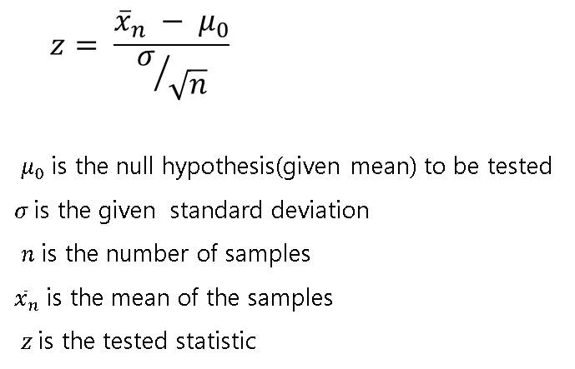
Hypothesis Testing (Z-test):
Binary Search Tree:
Easy for Data Retrieval
Has better Time Complexity

Slide 12
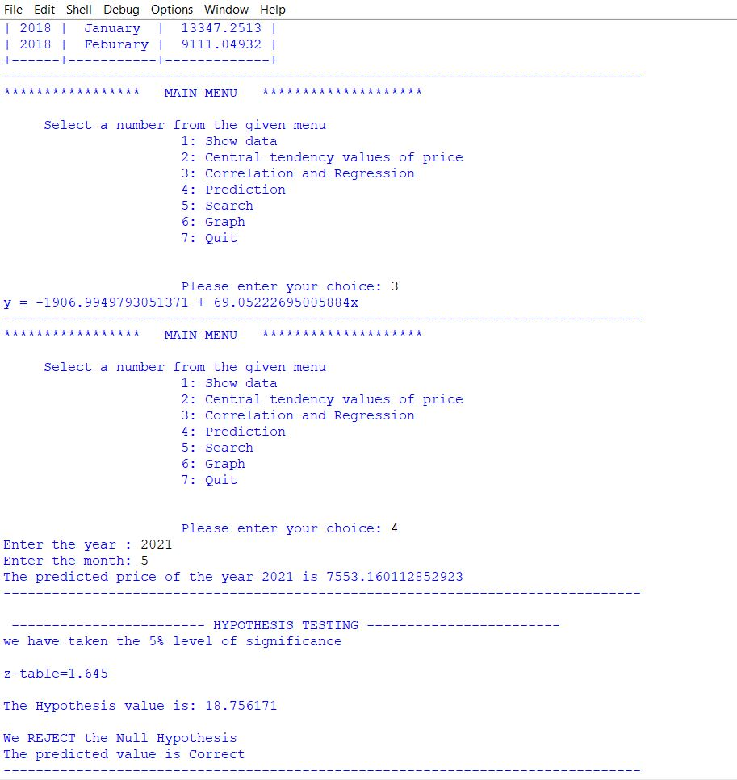
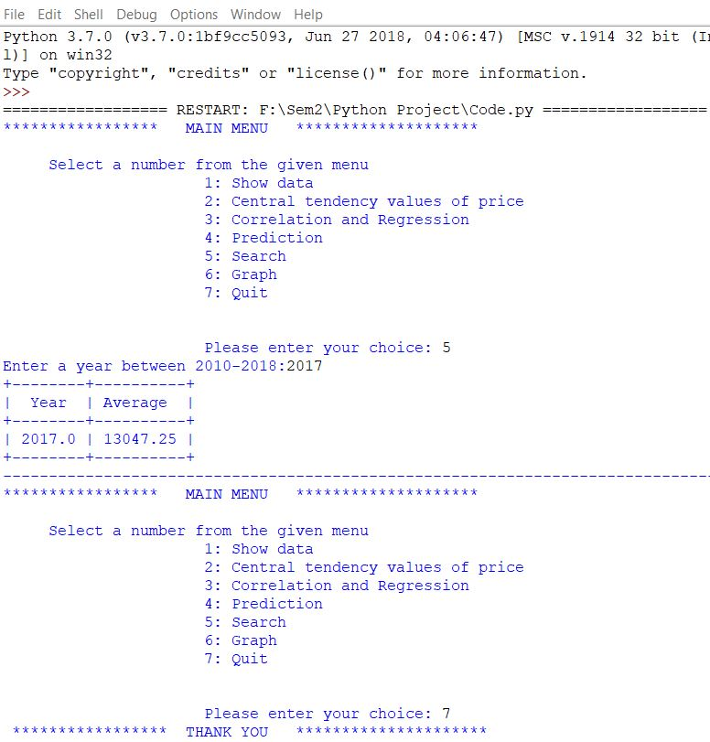

Slide 13
PREDICTED GRAPH
Interpretation:
The graph shows, The Increase in Price of Bitcoins in the forth coming 6years, till 2025.
As predicted, there is an increase in Bitcoin price, large amount of returns is possible in bitcoins.
Increase in number of users can make it an official currency, which would make bitcoin to mark itself it's position in future.

Slide 14
THANK YOU

